Slide 1


Serbia Education Sector
Preliminary Findings of the Functional Review and Options for Reforms
Belgrade, March 31, 2016

Slide 2

Section 1—Context

Slide 3

Skills are a critical foundation for jobs
Cognitive, Socio-emotional, and
Technical skills
Technical skills
Socio-emotional skills
Cognitive & Socio-emotional skills
Cognitive & Socio-emotional skills
Before school
Formal education
Adult education and training
ECD
Formal Education System
Training Landscape
Source: Alexandria Valerio, World Bank.
Economic development increases demand for occupations with higher-level skills.
Notes:
As countries become richer and move up the value-added chain, the type of skills requires change, often with growing demands for high-level cognitive skills (analysis, problem solving, and communication). Good quality education and LLL offer resilience to automation.

Slide 4
Cognitive skills: Serbia’s Performance in PISA
Share of students performing below Level 2 and at Level 5+ in Math
Percent
Low performers
Top performers
Source: OECD, PISA 2006, 2009, and 2012
Notes:
It is advancing, but very very slowly.

Slide 5
Poland’s Performance in PISA
Share of students performing below Level 2 and at Level 5+ in Math
Percent
Low performers
Top performers
Source: OECD, PISA 2003, 2006, 2009, and 2012

Slide 6
The Serbian education system is inequitable…
≈ 1 year of schooling*
Source: OECD, PISA 2006, 2009, and 2012

Slide 7
Early Childhood Education and Care Project
Focus on increasing access, quality, equity
  Access to preschool (currently 50%)—Involves the expansion of the kindergarten network and (potentially) retrofitting primary schools to also accommodate preschool services.
  The project particularly focuses on children from socially disadvantaged backgrounds.
Source: OECD, PISA 2006, 2009, and 2012

Slide 8
Section 2—Functional Review

Slide 9
Serbia Spending on Education

Slide 10
Education responsibilities vary by level of government
Local Governments—spend 15 to 20% of their budget on education
  Preschool costs—Under 10% of local government’s spending (Copayment of 20% from parents).
  Maintenance cost of school facilities and utility bills (heating, lighting, and the like)—Between 4 to 6% (World Bank, 2013).
Ministry of Education
  Basic and Higher Education
    Teacher salaries
    Curriculum development

Slide 11
Objective of the Functional Review
Explore space for efficiencies in the service delivery of the (pre-university) education (sub)sector.
Phase I—Situation analysis of staffing
Phase II—Ongoing
  Wage-bill analysis
  Job analysis
  School network analysis (kindergartens, primary, and secondary schools)

Slide 12
More than 90% of the (MoESTD) budget goes to salaries….
Para-educational Workers
School Directors and Principals
Desk-bound/Administrative workers
The majority of the budget goes to teachers… followed by manual workers
Manual Workers
Teachers, Educators & Practical Training Teachers
Source:
Notes:
Most of the education budget goes to teachers.

Slide 13
Distribution of staff in lower secondary education (%)
Percent
Other Staff
School Mgmt Personnel
School Admin Personnel
Personnel for pedagogical support
Teachers
Source: TALIS, 2013.

Slide 14
Situation Analysis in Broad Terms
Large number of (small) education facilities in the national school system
Large national instructional workload: proliferation of types of programs (TVET profiles, currently 278) and elective subjects.
Large number of norms that:
May be either too generous/inefficient
Do not reflect the actual workload

Slide 15
Student population declines, but schools remain
Source: Authors’ calculations based on data from the Statistical Office of the Republic of Serbia.

Slide 16
Declining enrolment leads to declines in school sizes and other key indicators
Source: Authors’ calculations based on data from the Statistical Office of the Republic of Serbia.

Slide 17
Large number of electives
Electives in primary schools (grades 5-8)
First mandatory elective
Second mandatory elective
Ecologists
Mother language / speech with national culture (Bosnian, Bulgarian, Bunjevacki, Hungarian, Romanian, Ruthenian, Slovak, Ukrainian, Croatian, Czech)
Chess
Foreign language
Physical education - selected sport
Informatics and computing
Everyday life in the past
Drawing, painting and sculpturing
Choir and orchestra
Household
Civic Education
Religion Education

Slide 18
Increasing the teaching norm (for some teachers)…
Total Hours of Work done by Math teachers
Hours of Teaching
….Could bring some savings in the short-term without compromising quality of education.
Source: TALIS, 2013.

Slide 19
Examples of norms that may be inefficient
Education spending is allocated based on inputs (often based on number of classes).
      Secretary, administrative and financial staff/officer are allocated based on number of classes.
      Cleaning staff are allocated based on the size and type of school.
It could be made more equitable if it is allocated on the number of students.

Slide 20
Options for reform—No silver bullet for savings
(almost all need a change in a law/bylaw)
Short-term (calendar year 2016)
Bring teaching loads for selected subjects closer to international benchmarks
Review the complexity of the curriculum (especially in grades 5-8 and TVET)
Medium-term (2-3 years)
Assess the feasibility of school network optimization
Improve administrative productivity (streamline procedures) & assess feasibility of consolidating administration in small schools.
Review, modify, and enforce organizational and staffing norms
Encourage teachers above Grade 4 to qualify to teach two subjects (multidiscipline)
Reform or simplify the curriculum (including TVET profiles)
Pilot alternative mechanisms of school financing (output-based instead of input-based)

Slide 21
Other policies to improve education service delivery
Increase the coverage of ECD, particularly for vulnerable children.
Measuring learning outcomes at the school level on a regular basis; and liking schools inputs (resources) with outputs (learning scores) to better inform policy decision-making in addition to equity measures (through an EMIS system).
Improve the equity of teacher quality and distribution by conducting a review of existing teacher deployment policies;
Realigning teacher deployment policies to ensure that students in vulnerable and underserved areas have access to high-quality professional pedagogues.
Improving teaching practices.

Slide 22
Section 3—International Experience

Slide 23
Areas of focus
Alternative approaches to school financing
School network optimization

Slide 24
What is Per Student Financing?
Also known as:
Formula Financing • Result-Based Financing
Per Capita (“Capitation”) Financing • Output-Based Financing
“Money Follows the Student” • Enrollment-Based Financing
This is the approach used in Western Europe and most OECD member countries
First piloted in the late 1960s and 1970s, then used to finance whole school systems in the UK, Netherlands, New Zealand by the 1990s (Fazekas 2012)
Used widely in transition countries of Central and Eastern Europe since the early 2000s (Alonso and Sánchez 2011)

Slide 25
Input-Oriented vs. Output-Oriented Financing
 | Input-Oriented Financing | Output-Oriented Financing
Efficiency & Incentives | Encourages use of more inputs (e.g., teachers, classes, auxiliary staff) | Encourages higher degree of outputs, achieving of results (e.g., students enrolled)
Transparency | Each school receives resources based on past allocations and ability to lobby or negotiate year-to-year increases | Each school receives allocation based on a clear predetermined formula
Equity | Focus is on equality of inputs, not on provision of equitable learning conditions (such as in schools with differential needs) | Funding formula can be used to achieve equity-related policy goals (e.g., more funding for schools with poor students)
Autonomy & Accountability | School directors are bound by restrictive input norms set by the central government (often decades ago) | School directors can decide how best to use resources for their school, are held accountable for results

Slide 26
Transition toward Per Student Financing in Eastern Europe and Central Asia (ECA)
Not started/ very early stages in discussions
Per student financing under discussion
Piloting of per student financing
Per student financing widely introduced
Armenia (2005)
Bulgaria (2008)
Czech Republic (1992)
Estonia (2001)
Georgia (2007)
Hungary (1990)
Kosovo (2002)
Kyrgyz Republic (2013)
Latvia (2009)
Lithuania (2001)
Macedonia (2009)
Moldova (2013)
Poland (2000)
Romania (2010)
Slovak Republic (2004)
Tajikistan (2010)
Uzbekistan (2010)
Belarus (2014)
Kazakhstan (2013)
Russia (1998)
Azerbaijan
Bosnia & Herzegovina
Serbia
Slovenia
Albania
Croatia
Montenegro
Turkey
Ukraine
Source: Adapted from Sondergaard and Murthi 2012.

Slide 27



Features of school financing formulas
Formula design: From very simple to complex
Total School Budget = A * N + B,
where N is the number of students
School Basket = K_{teach} + K_{non-teach},
where
K_{teach} = h/P * R * 1/N * (1 + K_{qual}/(5*4*12) + K_{adm} + K_{soc})
and
K_{non-teach} = TB + TA + PPT + CD + VG + L
Source: Alonso and Sánchez 2011.

Slide 28
Features of school financing formulas (cont.)
Desired objectives: What is the formula designed to achieve?
The objective(s), which must be explicitly stated beforehand, should determine the formula design—not the other way around
Objectives can include: improving efficiency, equity, quality, adequacy, transparency, accountability, and so forth
But having multiple objectives can lead to situations where they come in conflict with each other
Formula coverage: What does (or does not) the formula finance?
Which schools? All school, all public schools, all urban/rural schools, all schools except small schools, etc.
Which expenditure categories? Only salaries, all non-salary costs, all recurrent costs, only expenses directly related to the teaching process

Slide 29
Features of school financing formulas (cont.)
Most common objective of per student financing in ECA countries is improving the efficiency of resource allocation
Countries with a legacy of central planning and input-based financing tend to lack mechanisms that create incentives for efficient resource allocation and use
Inertia in planning and budgeting processes (such as complicated systems of outdated norms) often prevents rational use of scarce resources
Some countries have used per student formulas to encourage optimization of school networks (consolidation of schools and classes, right-sizing of teaching and non-teaching staff)

Slide 30
2. School Network Optimization
This is the demographic reality of a typical country in Eastern Europe…

Slide 31
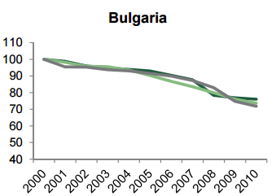
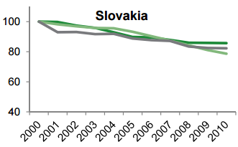
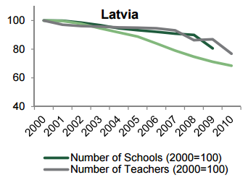
School Network Optimization (cont.)
Some choose to adjust their school networks to this reality…
While others do not…
(until it’s too late)
Source: World Bank (2013).

Slide 32
Declining class and school size has a profound effect on quality of education
World Bank research from across the region shows:
Strong correlations between declining class and school sizes and access to a quality learning environment
Particularly pronounced effects in rural areas where consolidation of classes within schools is less feasible
Difficult trade-offs in resource constrained environments (low student-teacher ratios vs. investment in learning materials or capital improvements)
Interrelated nature of quality, equity, and efficiency considerations

Slide 33



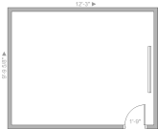
Experience shows several benefits to a consolidated school network
No change |  | Consolidated network
= “200” |  | = “200”
Butter is spread too thin: Too many teachers, with low salaries Too many buildings to maintain |  | Better use of resources: Fewer, better paid teachers Have more resources for books and computers

Slide 34
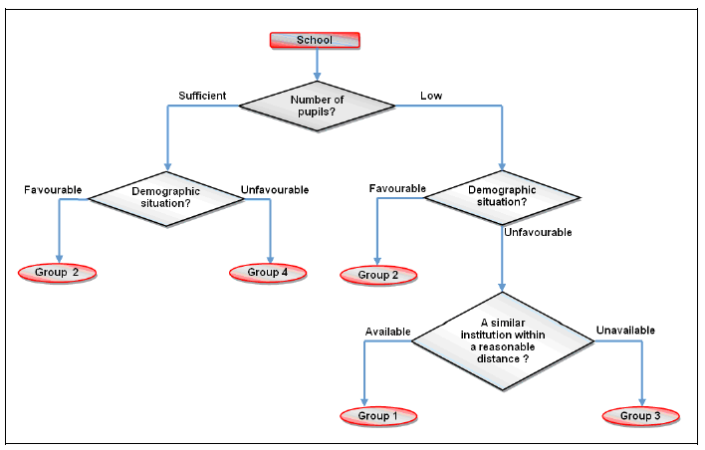
But analysis & strategic planning is needed
Step 1: Assessing feasibility of school network optimization

Slide 35
Analysis & strategic planning (cont.)
Step 2: Calculation of costs and benefits
Such reforms may pay for themselves in the medium term (through reduced operating costs and higher quality education)
But consolidating schools for fiscal reasons alone is not advisable, as the amount of fiscal savings may prove disappointing
The main reasons to do this center on equity and quality
Costs | Benefits
Transportation | Reduced operating costs
Rehabilitation of receiving / hub schools | More optimal class and school sizes
Transfer or severance packages for staff | Equitable access to good learning env.
Public information campaign | Higher quality education (medium term)

Slide 36
Analysis & strategic planning (cont.)
Step 3: Designing a solid implementation plan
Necessary legislative changes
Public information campaign
Transportation options
Staff relocation / redundancy
School rehabilitation
Provision of learning equipment and teaching materials
Creative uses of existing educational facilities are key: for example, retrofitting primary schools for Early Childhood Development (ECD) classes

Slide 37
Thank you!

Slide 38
Annex

Slide 39
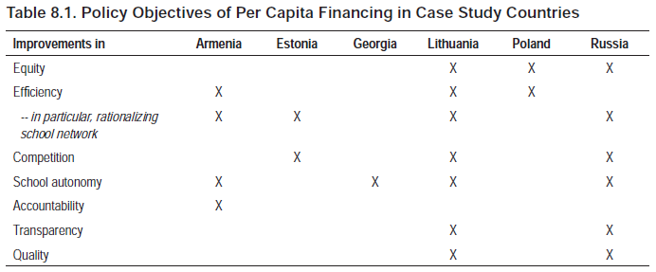
Thank you!
Source: Alonso and Sánchez 2011.

Slide 40
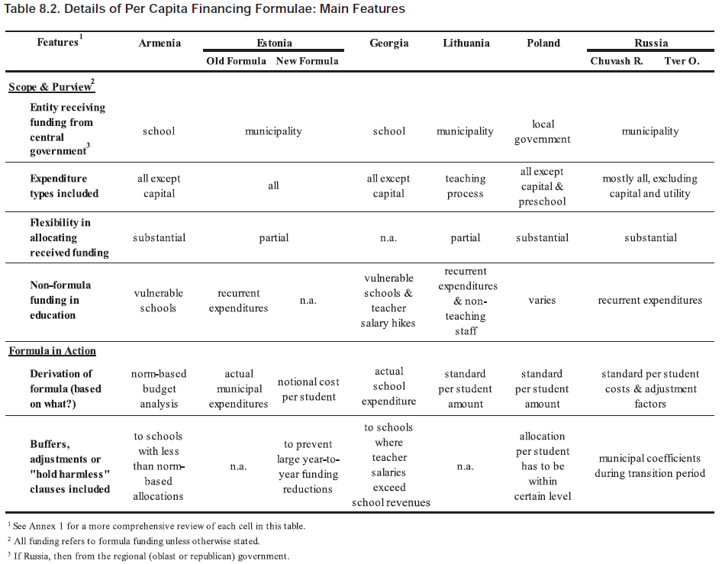
Thank you!
Source: Alonso and Sánchez 2011.

Slide 41
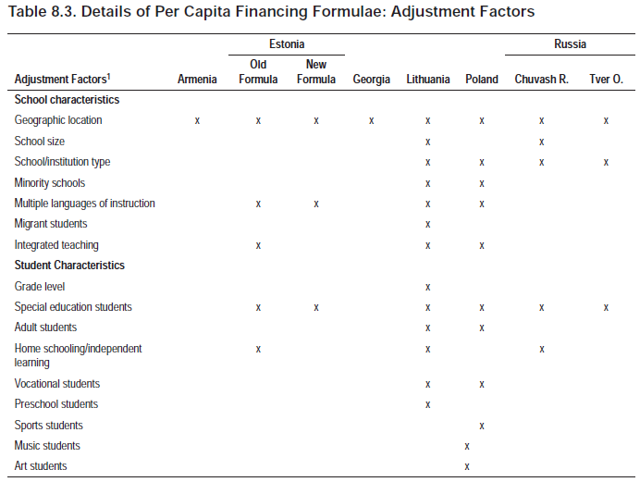
Thank you!
Source: Alonso and Sánchez 2011.

