Slide 1

Health Sector
Functional Review
Context & Preliminary Results for Policy Options Discussion
Health Sector Workshop
Belgrade – March 24, 2016
World Bank Group

Slide 2
CONTEXT
Health sector findings
From World Bank’s Public Financing Review

Slide 3
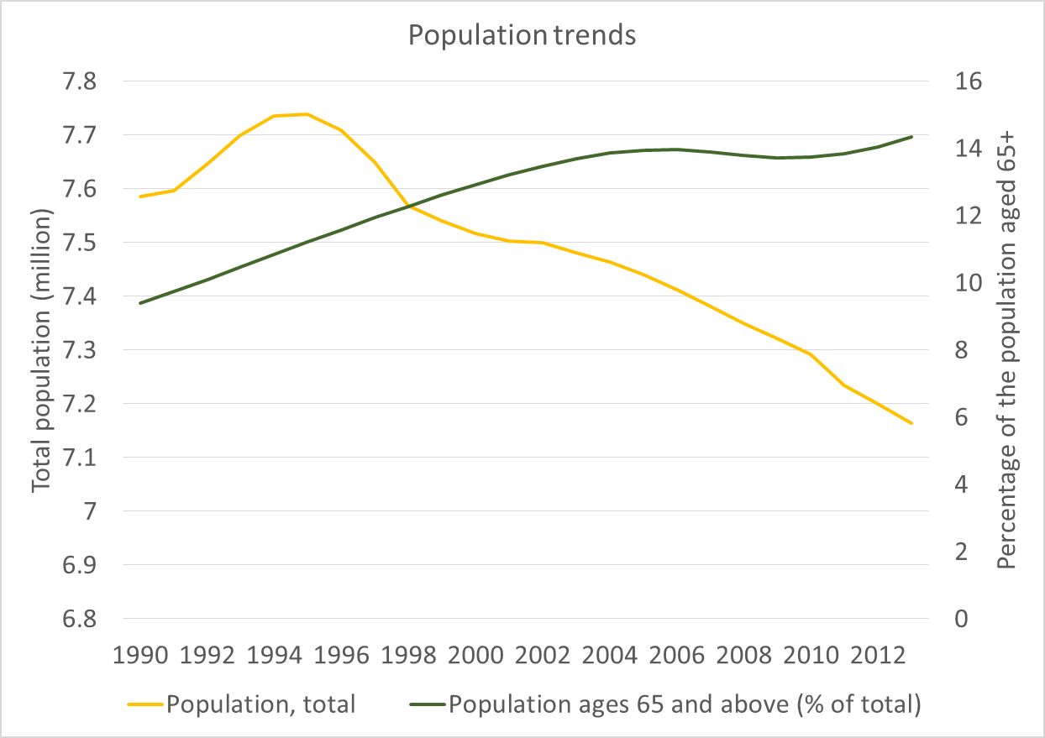
The population of Serbia is aging and declining…

Slide 4
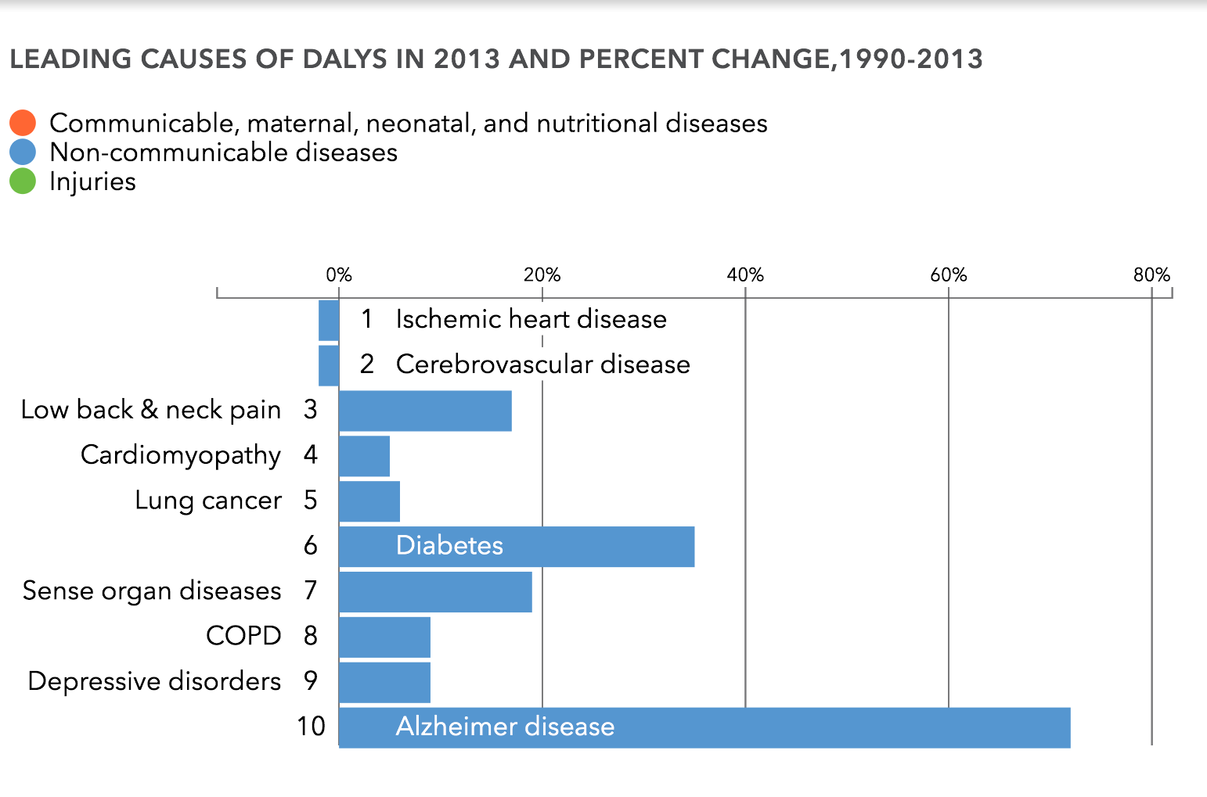
And NCDs keep increasing as the top causes of Serbians’ burden of disease

Slide 5
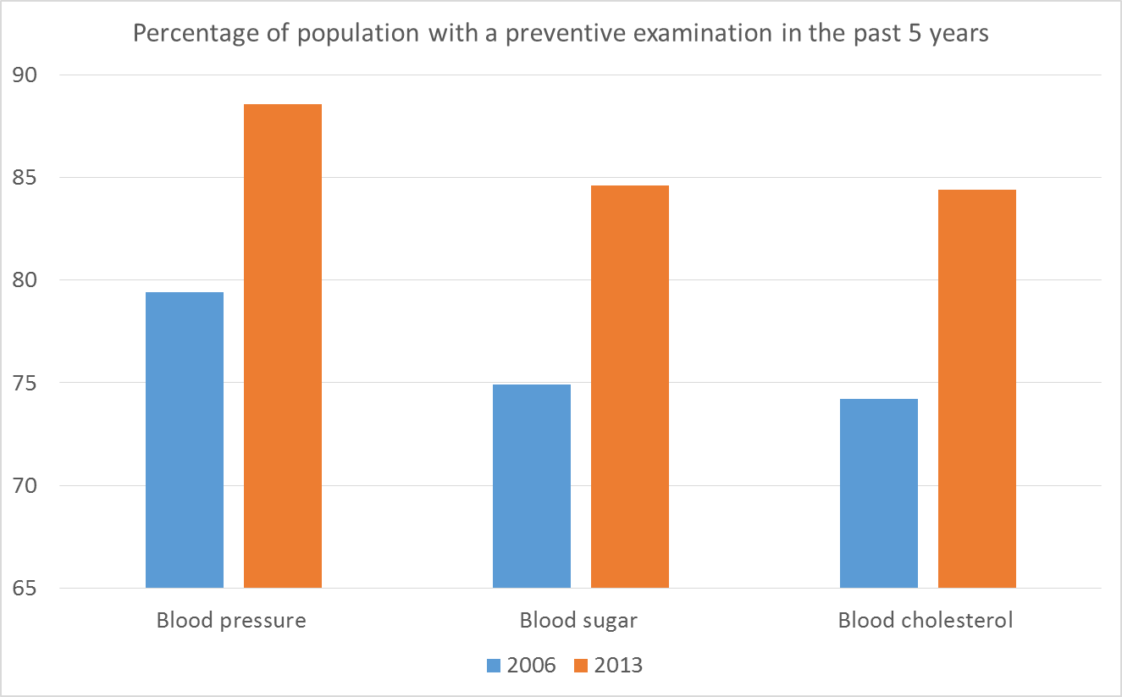
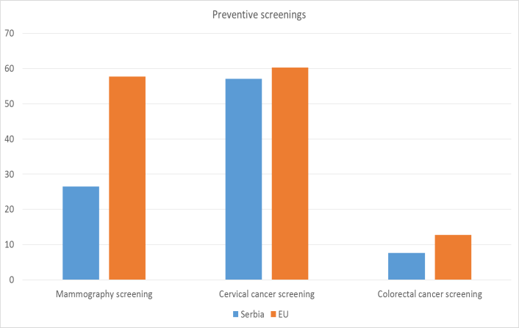
Preventive interventions increased but identification of patients at risk & screenings below average
Preventive Examinations
Preventive Screening Rates
Notes:
Fig 7: Source: National Health Survey 2006, and 2013
Fig 8: Source: National Health Survey 2013 and Health at a Glance 2014

Slide 6
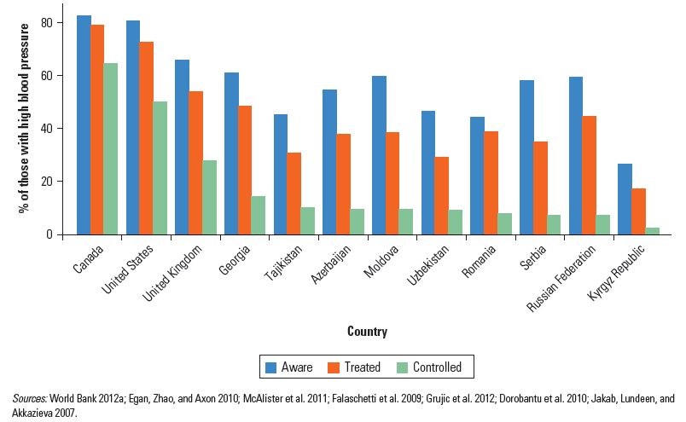
NCDs are not being adequately controlled: example of hypertension

Slide 7
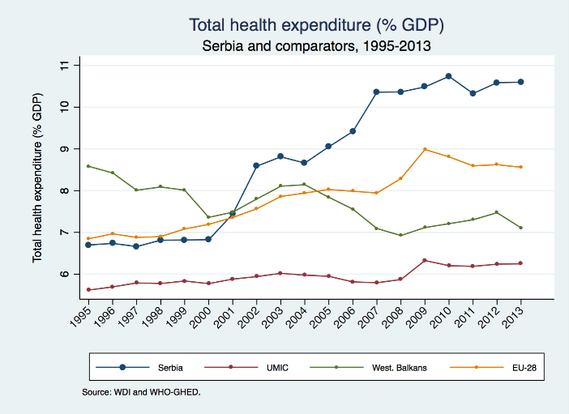
Total Health Expenditure (THE) is already high & increasing at a fast pace

Slide 8
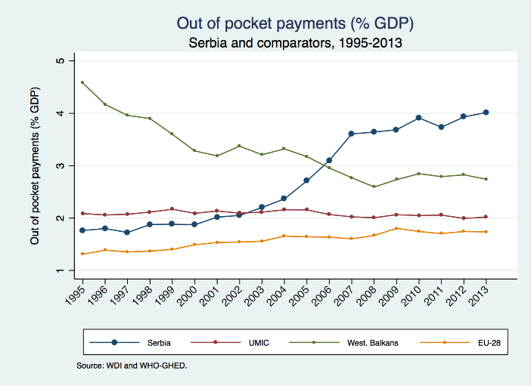
THE growth is fueled by private expenditure specifically already high OOP & keeps increasing

Slide 9
The problem with out-of-pocket payments (OOP)
They impose significant risk on households
  OOP can result in “catastrophic” or “impoverishing” episodes for households
They cause inequality in access to care between rich and poor
They may reflect rent-seeking by providers at the expense of the population

Slide 10
Summary of Recommendations from the Health Section of the Public Finance Review
Reduce excess staff, address arrears
Achieve cost-savings on pharmaceuticals and medical devices – price and volume controls
Implement provider payment reforms for primary care and hospitals, together with public administration reforms
Improve efficiency of services: hospital rightsizing, day surgeries, social care, clinical protocols, monitoring
Enhance quality and access to primary and preventive care

Slide 11
Health Sector
Functional Review
Preliminary Findings

Slide 12
Functional Review Analytical Components
1.Quantitative: Health Services Productivity
Efficiency by facilities
Wage Bill Simulations
2. Qualitative: Health System Functions
Legal & Regulatory Framework on clear roles of institutions, overlaps & gaps
3. Qualitative Management of Health Care
Allocative efficiency
Purchaser/provider split
Status & Use of new management tools for PHC & Hospitals
Short term recommendations
Medium-Long Term Policy Options

Slide 13
Quantitative Analysis
Generate
Working Hypothesis
In-depth facilities qualitative analysis

Slide 14
HIF financing is most important part of health facilities’ budget

Slide 15
    Salaries represent largest share of budget across all types of facilities
Notes:
Current expenditure have about the same importance in the budget across most facility types.
Within current expenditure however, expenditures for employees represent a large portion, but it varies across facility types in importance.

Slide 16
    Non-medical staff represent between about 25% of total staff in PHC and general hospitals.

Slide 17
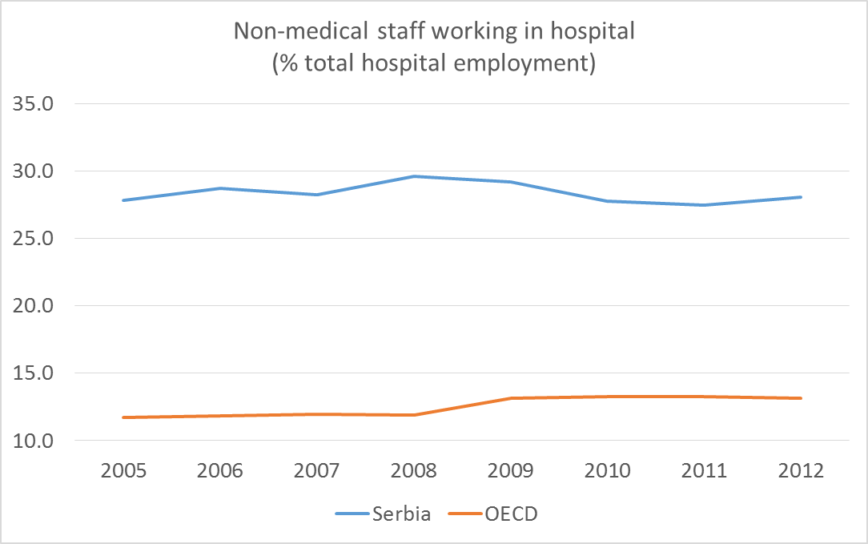
    Share of non-medical staff is substantially
    higher compared to the OECD average

Slide 18
Variations in Efficiency Across Inpatient facilities suggests that there is scope of improving

Slide 19
Quantitative Analysis:
Summary of Preliminary Findings
Descriptive analysis
Revenues mostly from HIF across the board
Current expenditure represents more than 85% of total expenditure
Employee compensation is the main driver, and the share of personnel spending varies both across and within facility types.
Econometric analysis
A reduction of about 10% in the share of non-medical staff could generate savings of about 3.4% in wage bill.
Substantial variation in technical efficiency for inpatient and outpatient care service provision.

Slide 20
Health Sector Functional Review:
Next Steps
Core HS functions
Central level Institutions: Roles, mandates, overlaps, gaps
Selective Review of Legal and regulatory framework
Health care management
Sampling of facilities based on efficiency
Review of management practices with field visits and semi-structured interviews
Key interventions & Policy
Options
Comparative analysis of core functions and management of facilities with relevant international best practices
Refine options for key interventions and policy options

Slide 21
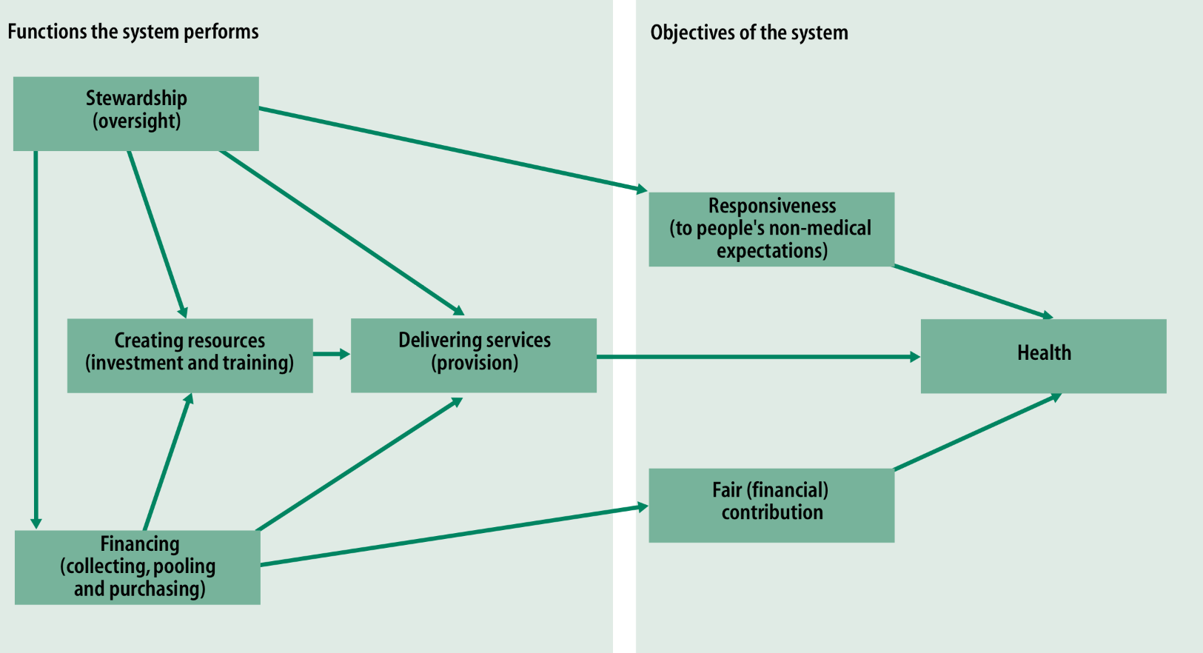
WHO Health Report of Year 2,000:
Health Systems Performance

